Slide 1
Client Services Consulting
2019 Update

Slide 2
Talking Points
Team Overview
Consulting Focus
Building New Opportunities

Slide 3
Team Overview
Client Services now in its 4th year of serving customers
  17 Consultants
  Strike Team
  User Xperience Support
  Branch AnyWhere install/support
Banking experts with cross product expertise
385+ combined years banking experience

Slide 4
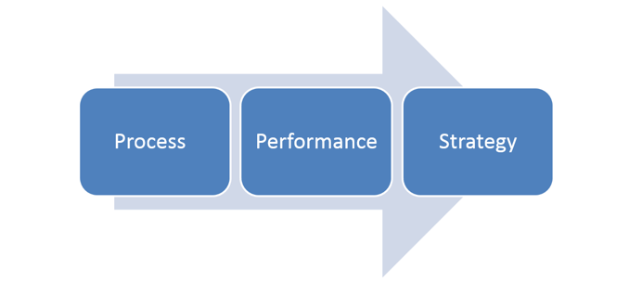
Consulting Focus
When you think banking strategy think Client Services Consulting…

Slide 5
Consulting Focus
Key differentiator in banking operations
  Thought leadership
  Banking processes
  Banking procedures
Goal is to ensure banks leverage products and services fully
Consultative approach is key
Thinking like a banker is essential

Slide 6

JHA Client Services Consulting – did you know?
Consulting Focus
We’re invested in the relationship and in it for the long haul. The customers success is our success.
We have 385+ years of banking expertise … we understand what our customers are doing and why they are doing it.
Our consulting team has the cross-application expertise to help customers understand how to best optimize usage of JHA products and integration touchpoints
We provide banking best practices guidance based on collective customer intelligence
We will work with customers to incorporate their growth strategies and goals into a formal plan; helping them build a roadmap that makes sense for them

Slide 7
Client Services Consulting
Operational Assessments
Infrastructure Consulting
Global Security
Treasury Management Consulting
“Day in the Life”
Migration Assistance Consulting
Tech Planning Consulting
Xp/XpTLR/Merge Document Consulting
Digital Design Consulting
Customized Consulting

Slide 8
Client Services Consulting
Operational Assessments
  Focus on ROI
  Focus on implementation of findings
  GL assessment/reorganization
  Loan assessment
  Deposits assessment
  NetTeller assessment
  Teller assessment
  Menu security assessment

Slide 9
Client Services Consulting
Operational Deposit Assessment
  Cross Application Item Entry
    Writing too many paper tickets
  Exception Item Processing – ACH
    Outgoing returns
    Incoming returns
    Large dollar item returns
  Charge off process
    Setup available interface lines

Slide 10
Client Services Consulting
Operational Loan Assessment
  Cross Application Item Entry
    fund new loans
    Payment split outs
  Update Loan types
    Payment posting order
    Participated loans – payment splits
  Charge off process
    Setup available interface lines

Slide 11


Client Services Consulting
$91,300
$84,630
Avg. Cost Benefit
per Assessment
Avg. Cost Benefit
per Assessment
Average ROI = 4.91 x cost of engagement
Average ROI = 6 x cost
of engagement
Notes:
Good “win” example with SilverLake Deposit Assessment for First Bank in McComb MS a $500 million SL OL customer. Overall cost benefits were $1,361,968 annually – a great portion of that was around ACH Transactions. The bank was allowing ACH entries to post early which meant they were losing NSF income and also paying interest a day earlier than needed….vs waiting for the ACH to post on effective settlement date which is what’s required. $1,343 of the cost benefits were due to the ACH finding alone.

Slide 12
Client Services Consulting
Infrastructure Consulting
Servers/Hypervisor Hosts
Physical, Virtual
Memory, Processor, Disk
Workstations
Physical, Virtual
Memory, Processor, Disk, Monitors
Network
Routers, Switches, Cables
Bandwidth, Latency
Software
Operating System
Applications
Notes:
What does the word Infrastructure encompass:
-Servers and Hypervisor Hosts
- Workstations (Thick and thin client)
- Network equipment and circuits
- Software (Operating Systems, JHA Applications, 3rd party applications)

Slide 13
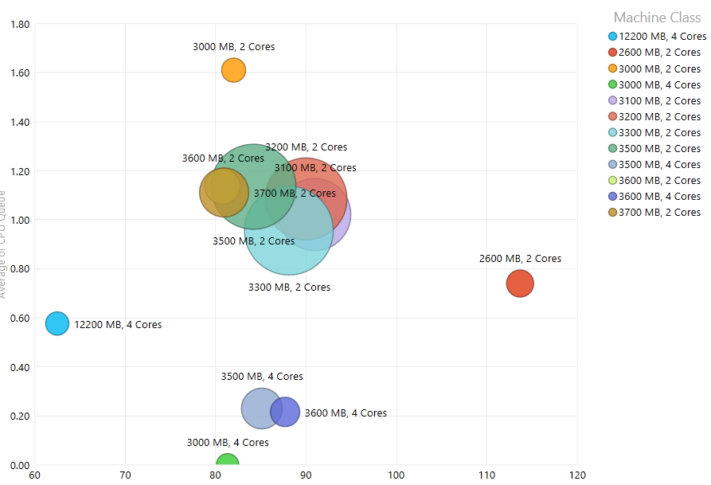

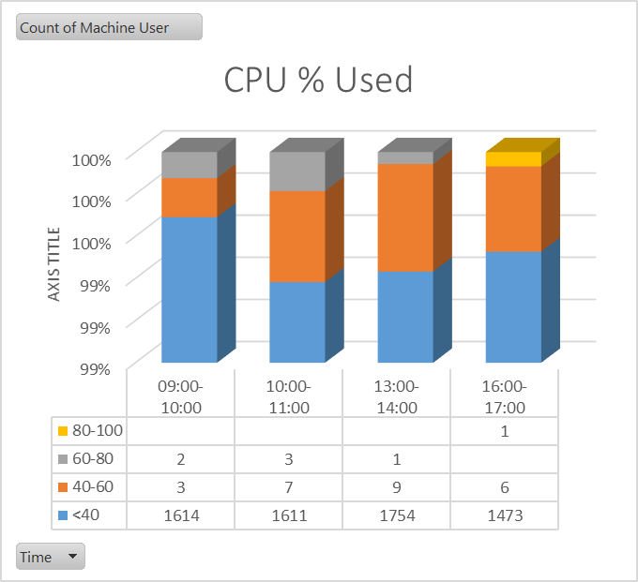
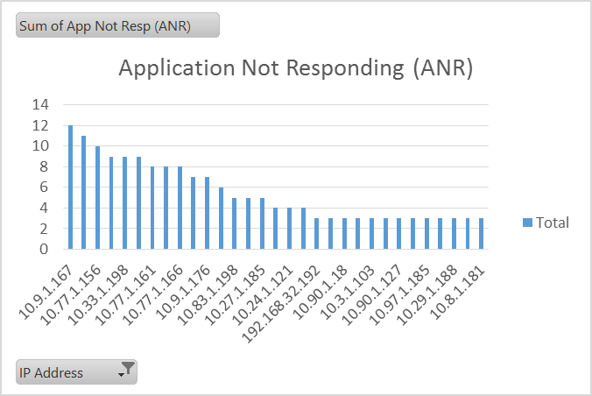
Benefits of Infrastructure Consulting
Client Services Consulting
Reduced cases for slow performance and product stability resulting in less user down time
Users are more effective and efficient at using their applications when the system is performing as it should
Higher User adoption rates for new applications
Consolidated inventory of all workstations, servers, and applications in institutions environment
  Prioritized by performance and other factors to assist with strategical upgrade process
  Upgrade the systems you need to upgrade, not just everything
Notes:
What are the benefits or return on investment?
- Reduced support cases from users due to a slow system not functioning to expectations
- Higher productivity as applications work faster and system is responsive
- Users are excited to work on a new, highly functioning system
- To do list of what needs to be upgraded to allow for a high performing experience for all users

Slide 14
Xperience™ Services: UXOps-Infrastructure@jackhenry.com
Client Services Consulting
Reduce support cases
Maximize existing resources
Improve User Satisfaction
Plan for the future
Infrastructure Health Check
  One time or multiple combined with rollout; option for quarterly reviews
Infrastructure Deep Dive
  Deep dive analysis of infrastructure, applications, and usage patterns
Technology Planning
  Current and future state infrastructure planning including environments, disaster recovery/high availability, and upgrade strategy
Physical to Virtual Analysis
  Review of current application usage to determine fit for virtual environment (Terminal Services, Citrix®, VMWare View)
Notes:
Here is a list of services that the Client Services Infrastructure team can provide you. Please reach out to the email listed here with any questions or to set up a time to meet and discuss your needs.
- Infrastructure Healthcheck – For FI’s that do not currently have Xperience rolled out to their users
- Infrastructure Deep Dive – For FI’s that have Xperience rolled out and are having performance issues
- Technology Planning – Plan for the future and plan for worst case scenarios
- Physical to Virtual Analysis – For FI’s looking to move from thick client workstations to a thin client delivery

Slide 15
Client Services Consulting
Global Security
  Employee interviews
  Assess current menu security
  Build roles/templates based on interviews
  Train Security Officer on how to manage
  Test with users
  Go Live

Slide 16

Client Services Consulting
Treasury Management Consulting
  Onsite strategic planning meeting
  TM parameter review (wires/ACH/EAA)
  Findings and recommendations document
Visions, goals and gaps
Review:
Current TM products and pricing
Marketing/Sales tools
Challenges/manual processes
Onboarding
Sales
Back office

Slide 17
Client Services Consulting
“Day in the Life”
  Role based approach to application training
  Role based approach to processes
  Role based approach to process improvement
  Role based approach to end user education
  Role based approach to end user efficiency
  Role based approach to happy bankers

Slide 18

Client Services Consulting
Migration Assistance Consulting
  In to Out Assistance with JHA/Bank tasks
  Discover 3rd parties affected by the move
  Constant communication liaison between JHA/Bank
  Overview look at the how the bank operates and how it should move forward

Slide 19
Client Services Consulting
Technology Planning Consulting
  Core neutral
  Focused on all products/services and not just JHA
  Considers pending implementations/projects
  Plans for future product offerings
  Discuss personnel resources/organizational chart
  Utilizes technology management approach
  Capitalize on JHA Education services
  Building technology plan timeline / action items list
    Identify gaps and find solutions
Approach varies depending on bank complexity and needs

Slide 20
Technology Planning – Strategic Consulting
Client Services Consulting
Assessment
  User
  Installed product
  Hardware capacity review
  Infrastructure review
SWOT analysis
  Identify hardware/software, and product knowledge (inventory of resource strengths within the organization).
  Identify areas of weakness that can be improved to better utilize installed products.
Gap analysis
  Identify process “pain points” to improve workflow.
On-site Strategic Planning Day
  Review Bank Vision, Mission, and Goals
  Address TOP priorities on gap tracking list
  Recommend solutions

Slide 21
Client Services Consulting
Xperience Consulting
  Xp Admin Consulting
  Build Xp end user consulting plan
  End user consulting plan rollout
XpTLR consulting
  Review environment
  XpTLR PC installation
  Perform test scripts and live transactions
Merge Document Consulting
  Merge Document design and management
  Identification and prioritization of documents
  Archive strategy

Slide 22
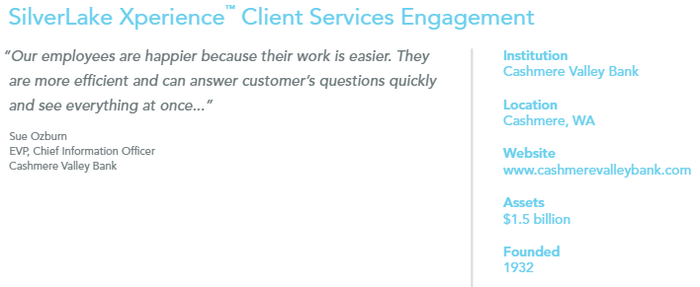
Client Services Consulting
Xperience Consulting Comments
  I have never been more impressed by a JH associate
  started using it today exclusively
  wants to roll this out to everyone as fast as possible

Slide 23
Client Services Consulting
Digital Design Consulting
  Separately branded digital bank
Easy – seamless – customer experience
  Onsite digital design meeting
  Build product matrix
    JHA or third party
  Review statement notice types
  Discuss/review customer experience
  Discuss/review associate/team member experience
  Findings and recommendations document

Slide 24
Client Services Consulting
Operational Assessments
Infrastructure Consulting
Global Security
Treasury Management Consulting
“Day in the Life”
Migration Assistance Consulting
Tech Planning Consulting
Xp/XpTLR/Merge Document Consulting
Digital Design Consulting
Customized Consulting

Slide 25
Client Services Consulting
Customized Consulting
  Key person replacement/Resource augmentation
  Procedure improvement/rewrite
  Enterprise Workflow – EWF
  Process improvement

Slide 26


Client Services Consulting
clientservicesconsulting@jackhenry.com

Slide 27
Client Services Consulting
Q: What has been the most contracted engagement for the Consulting Services team in FY18/FY19?
A. Xperience
B. SilverLake Assessments
C. SilverLake Global Security
D. 20/20 to SilverLake Migrations
Notes:
Good “win” example with SilverLake Deposit Assessment for First Bank in McComb MS a $500 million SL OL customer. Overall cost benefits were $1,361,968 annually – a great portion of that was around ACH Transactions. The bank was allowing ACH entries to post early which meant they were losing NSF income and also paying interest a day earlier than needed….vs waiting for the ACH to post on effective settlement date which is what’s required. $1,343 of the cost benefits were due to the ACH finding alone.

Slide 28

Objective
Strike Team Update
Fully deploy Xperience for Jack Henry's banking customers, including core and complementary products by 12/31/2019
In order for the bank to be fully rolled out by that date, they should be installed by September, 2019!!!!!
Notes:
First step: We worked with the Executive team to create a Project Charter,
It stated the Objective of Project and high-level requirements to bring the vision to reality.
(see slide)

Slide 29

Strike Team Update
689+ Xperience Installations with complimentary products in 7 months
Conception, Architecture, and Implementation of the process flows
Successfully mapped over 50K screens
Created online suite of eLearning classes and webinars
Enhanced client relationships across the customer base
Developed Support group to service client base

Slide 30
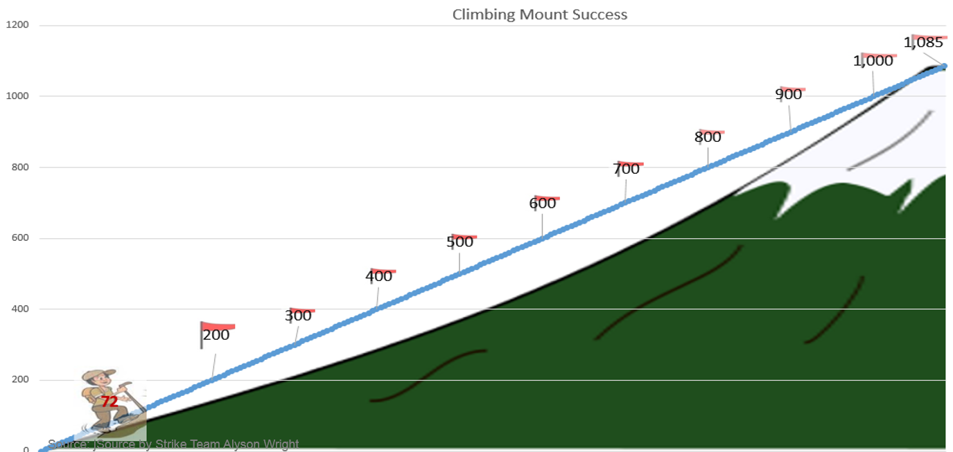
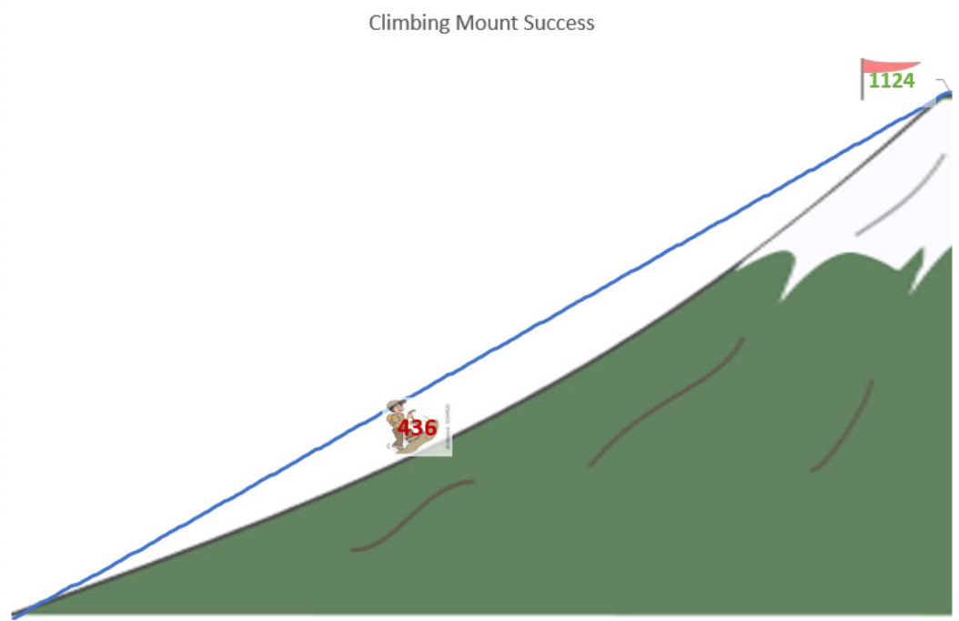
Strike Team Update
Scope: Overall Core XP
68%
1,069
1%
Movin’ on up!
724
8
Feb 2017
April 15, 2019
Notes:
So how are we doing with Scope?
This time last year, Only 15% of customers were on full core XP when we started
We’re up to 436 today! That’s 39% of all customers!
Fantastic progress!
Go Strike Team!

Slide 31
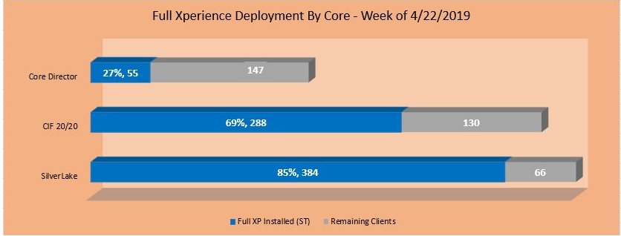
Strike Team Update
Scope: Overall Core XP
Notes:
So how are we doing with Scope?
This time last year, Only 15% of customers were on full core XP when we started
We’re up to 436 today! That’s 39% of all customers!
Fantastic progress!
Go Strike Team!

Slide 32
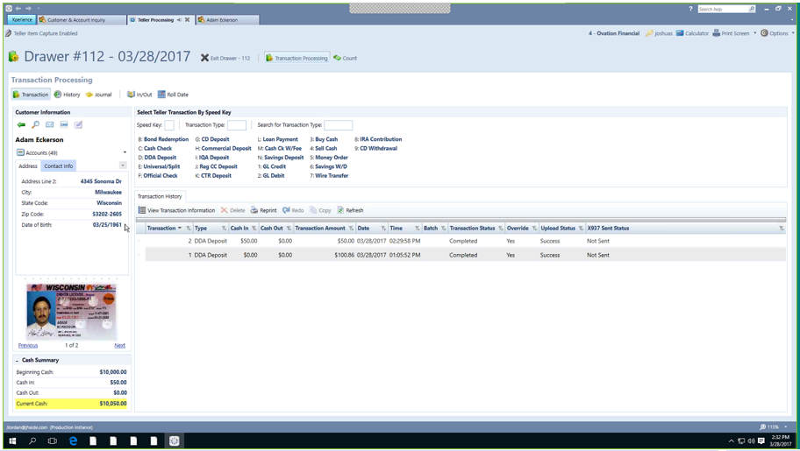
Xperience Teller Update

Slide 33
SilverLake® & CIF 20/20® Teller Migrations
Xperience Teller Update
Published deadline to contract for the migration is March 31, 2019
Implementations will be completed by September, 2019

Slide 34
Xperience Teller Update
General Process Overview
Download Teller Packages
Configure One Workstation
Confirm Date of Install
Confirm Use of Physical Workstation
Issues reported to NAT
Bank Controlled
Readiness
Install
Rollout

Slide 35

Xperience Teller Update
Install Timeline
60
30
21
Confirm
physical workstation
install date
Intro email
Next steps
KO call –
Coordinator
Bank IT
Vertex Admin

Slide 36

Xperience Teller Update
Strike Team configures one physical workstation
Bank controls how/when rollout occurs
VDI/Thin Client –
  Physical workstation is needed to install
  Physical workstation needed for support
  Physical workstation needed for DR/DA

Slide 37

Client Services Consulting

