Slide 1
Jack Henry Solutions Overview
Sarah Dyess, Product Marketing Specialist
May 6, 2016

Slide 2
Relationship 360
Sarah Dyess, Product Marketing Specialist
May 5, 2016

Slide 3
Agenda
What is Relationship 360
Benefits to Your Bank
Summary of Features
Live Demo
Customer Success Stories

Slide 4
What is Relationship 360
R360 leverages your core data to create programs and/or products that drive revenue and customer loyalty.
Jack Henry partnered with Saylent Technologies in 2008 to offer an integrated business solution.
Integrated to the SilverLake cores.
Leverages a market leader’s expertise to facilitate a positive ROI.

Slide 5
Benefits to Your Bank
Understand Customers Behaviors
Develop Strategies to Align with FI’s Goals
Drive New Revenue
Attract, Retain & Expand Relationships
Move Customers to Efficient/Less Costly Channels
Grow Deposits
Consolidate Products/Service Charge Codes

Slide 6
Summary of Features
Business Intelligence and Automation
Analytical Tool-Leveraging Core Data
Flexible and Customizable
Integrated with Core, Hosted by JHA
Backed by Bank Specialists and Design Experts
A Product Strategy for Creating New Fee Income and Lowering Operating Costs

Slide 7
R360 Offers Flexibility
You choose the desired behaviors a customers must satisfy.
Rewards may be in the form of:
Interest
Service Fee Rebates
Cash
Transaction Fee Refunds
ATM Surcharge Rebates

Slide 8
R360 Offers Flexibility
Account Level Rewards
Evaluates & Rewards a Single Account.
Relationship Rewards
Managed at the Customer Level.
Focused on Customers’ Banking Relationship.
Aggregates balances.
Annual Rewards
Evaluates & Rewards consistent behavior over the year.
Bonus Rewards
Reward that pays out as a % of a previously earned reward or based upon annual activity of a named transaction.

Slide 9
JHA Banks Leverage R360…..Proven Value
• Increases Revenue • Attracting Customers • Retain Profitable Customers •
• Encourage Profitable Behaviors • Improve Competitive Positioning •
“R360 allows us to offer appealing products that can set us apart and attract prospective customers, and allows us to deepen our relationship with existing customers.”
Capital Bank
$230 increase in annual Account Profitability
Balances 3X larger
Customer life 2X longer
eStatement up 10X
Debit usage up 92%
Online banking up 300%
Debit Income 4X larger
Over 700% ROI
Over 50% increase in profits
66% increase in revenue
“Our newly designed Rewards Checking Account program has quickly become our most profitable per-customer account.”
First State Bank
“You don’t have to be satisfied with off the shelf solutions. With R360, you are empowered to deliver exactly what your customers tell you they want.” Extraco Banks
“R360 let us design a checking account program that really differentiates us from the competition.”
The Bank of Maine

Slide 10
Relationship 360
Live Demo

Slide 11
What Other JHA Banks Are Doing
First State Bank – Middlebury, IN
Goals Retain Customers Acquire New Accounts
Challenges 5 Local Banks Providing Essentially the Same Product Improve Customer Rewards & ROI to the Bank
Incentive Waived Service Fee with e-Statement 5%-3%-1% Interest ATM Surcharge & ATM Bank Fee Rebates 10¢ Back on Signature Use
Results Reversed Acquisition & Retention Trends Added $7.30 Net Profit Per Account Per Month

Slide 12
What Other JHA Banks Are Doing
Capital Bank – Raleigh, NC
Goals Increase E-Statements Increase POS Activity Increase Direct Deposit ATM Usage
Incentive Provide 40% Service Fee Refund with Debit Card Activity and Direct Deposit Minimums.
Results Debit Card Rate Increased from 4 Transactions/Month to 12. Debit Income is $13 Higher Per Reward Account Over a 9 Month Period.

Slide 13
Customer Experience
Bank of Maine – Portland, ME
Goal Grow Accounts
Qualifiers 2 Bill Pays, Direct Deposit, 12 Debit PINS, E-Statements
Results Added 5000 New Accounts in 9 Months - +10%
* Bank of Maine was acquired in 2015 by JHA customer Camden National. After research and comparison it was found Promise Checking was more profitable than any other Camden consumer product.

Slide 14
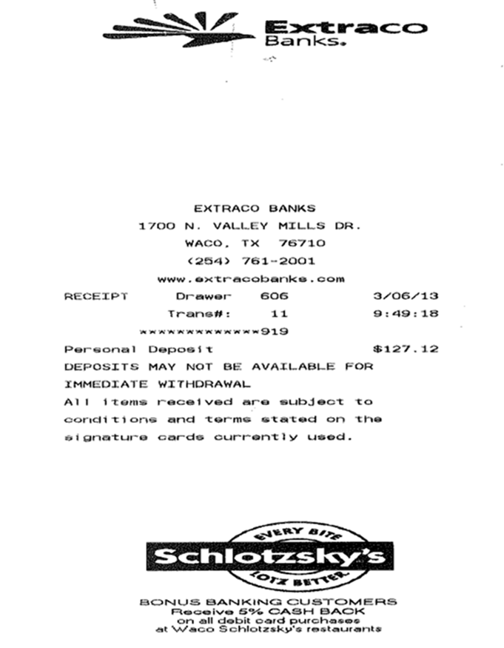
What Other JHA Banks Are Doing
Extraco Banks – Temple, TX
Goals Build profitability in retail and small
business checking. Provide a merchant
funded cash back rewards incentive.
Incentive Cash Back for Consumer Customers
if a Debit Card is Used at a Local
Business. (ExtraRewards Program)
Results 11% Increase in annual Debit Card
Interchange Income. 200+ Commercial Customers Signed Up for the Program Increased Business & Advertising Exposure for Commercial Customers. Increased Business & Customer Loyalty.

Slide 15
Saylent’s Advisory Services
Advisory Services
Product Strategy Assessment
Analysis of bank performance, market opportunities, competition, & customer data driving a set of custom product recommendations.
Products are tuned to each bank and their unique needs.
Product Launch Plan
Detailed document outlining all tasks involved in a complete successful product introduction.
May include a turnkey executive summary or business case for the bank to deliver to their management or product committee.
Ongoing Reviews
Quarterly reviews of product performance, identifying areas for improvement.
Reports use R360 to analyze customer behavior & convert to an ongoing ROI to support the continued use of the product.

Slide 16
GO TO Market
Banking & Reward Experts
Independent Assessment of Market Situation/Opportunities
Discuss Your Objectives and Desired Direction
Provide Guidance and Advice on Best Practices
Manage Implementation Timeline
Training on the System
Ongoing Consultative Services

Slide 17
Benefits
New Marketing Power
Creating Stronger, More Profitable Relationships
Attracting New Customers from Desired Segments
Promoting Efficiency in Customer Banking Behaviors
Drive More Profitable Behavior, Producing the Desired Results
Design Programs that Differentiate your Accounts from the Competition

Slide 18
Xperience Overview

Slide 19
What is Xperience
Modernization of Jack Henry Products
Attractive, functional and flexible presentation system.
Provides a common look and feel expected by all products.
Provides the end-user a consistent experience.

Slide 20
Xperience Products
SilverLake Core
Teller
OnBoard Deposits
Call Center
Synapsys, CRM
4|Sight
Synergy
Enterprise Workflow
PowerOn

Slide 21
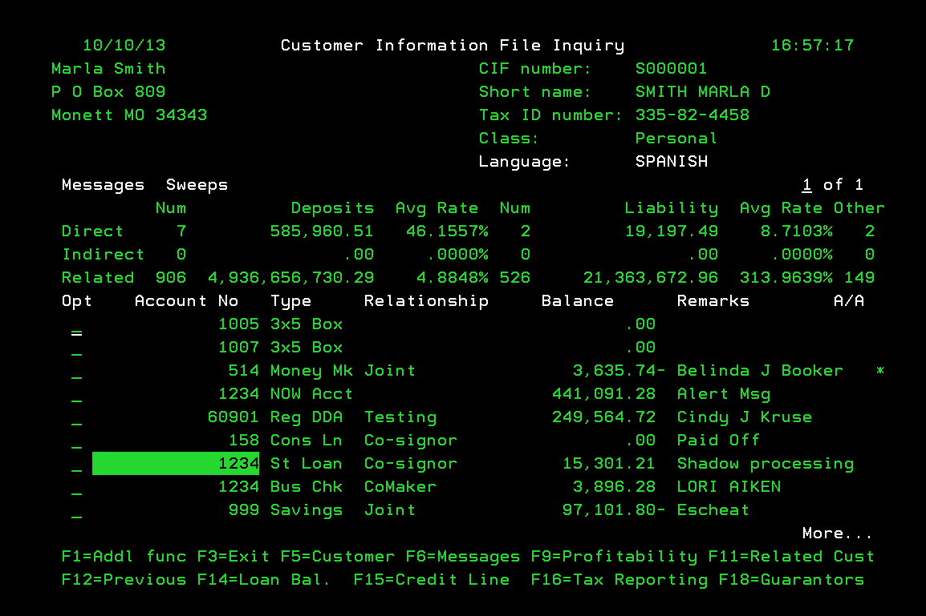
INSERT A GREEN SCREEN CUSTOMER INQUIRY HERE
Notes:
Back in the 80’s this is what your core customer inquiry screen looked like

Slide 22
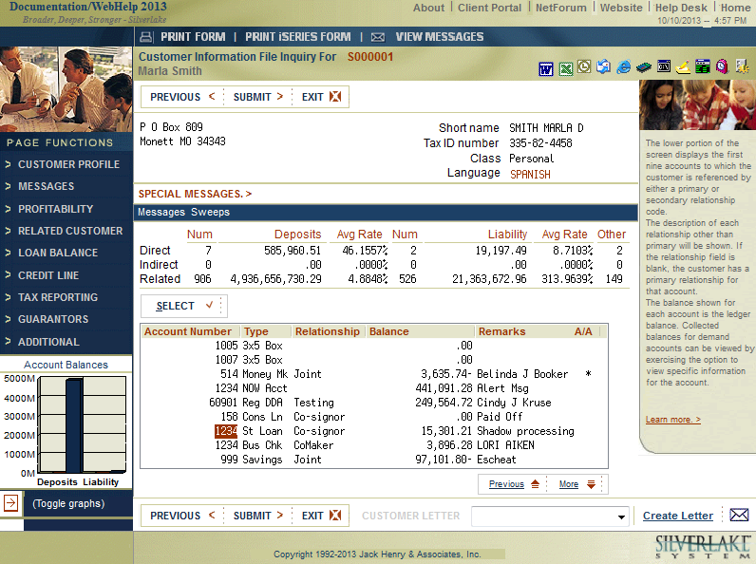
Browser screen
Notes:
This is what we rolled out in the early 2000’s

Slide 23
jhaEnterprise Workflow (EWF)

Slide 24
jhaEnterprise Workflow
jhaEnterprise Workflow simplifies business processes by fully automating, streamlining, and standardizing any procedures that involve multiple steps, individuals, groups, departments, and systems.
Supports virtually any process that is performed with a series of consistent steps; automatically routing assignments based on established credentials, permission levels, and availability.

Slide 25
Benefits of jhaEnterprise Workflow
Integration
Standardize business processes and procedures
Streamline information access and distribution
Improve operating efficiencies while reducing costs
Enhance response time and service
Distribute work automatically, while ensuring accountability and measurement
Support linear and/or parallel work processing

Slide 26
Workflow Business Process Example
Step 1
Loan Application
Step 2
Get Credit Rating
Step 3
Credit Review
Step 4
Loan Committee
Step 5
Review Documents
Step 6
Close Loan
Step 7
Book Loan
Step 8
Documents to Synergy

Slide 27
Workflow Death Certificate Example
Step 1
Death Certificate Filed Through Synergy
Step 2
Step 3
Auto Determine if Customer is Already Deceased
Step 4
Auto Set Deceased Flag to ‘Y’
Step 5
Auto Gather Accounts from SilverLake
Step 6
Auto Determine Account Relationships
Step 7
Auto Maintain Accounts (Restriction or Alert)
Step 8
Auto Refile Documents to Synergy
Auto Pull CIF Information from SilverLake

Slide 28
OnBoard Deposits Deposit Origination

Slide 29
Integration
CRM (Synapsys) Referral
Deposit Platform (OnBoard Deposits)
Identity Verification Inquiry
OFAC Verification
Check Ordering Interface
ATM / Debit Card
AFT / ACH / Sweeps
Combined Statements
Internet Banking (NetTeller)
BSA Integration
Document Imaging / eSignature Capture (Synergy)
Teller Funding (SilverLake Teller) and Signature Inquiry
Internet Banking (NetTeller) Inquiry/Activity
Mobile Banking (goDough) Inquiry/Activity
SilverLake Inquiry and Document Imaging Inquiry (Synergy)

Slide 30
Features of OnBoard Deposits
OnBoard Deposits features a customer centric process where account opening input is based on type of transaction and data required to complete in a timely and compliant manner.
Supports compliance based dynamic forms from CSi and WKFS.
Provides interest calculators, quick links, and quick documents in a single sign-on environment to make users efficient and able to deliver a positive customer experience.
Complementary Interfaces (via jXchange™)
Synergy eSign™
YellowHammer BSA
PassPort
Customer Verification with ChexSystems or Deluxe Detect
Check Vendor
OnBoard Product Roadmap for Integration
CRM (Synapsys)
jhaIDScan
Maintenance Integration
jhaEnterprise Workflow
Branch Anywhere

Slide 31
StreamLine vs OnBoard Deposits
Streamline Deposits
Static forms
Mainframe based
Bank determines forms
Form updates manually
Integration with core, others
OnBoard Deposits
Dynamic forms
Xperience based
System determines forms
Form updates automatically
Integration with core, others
Compliance Guarantee
jXchange SOA
Focus groups input

Slide 32
Taking Technology Outside of the Bank

Slide 33
Branch Anywhere
Branch Anywhere™ is the first JHA companion app
Any Product, Any System, Anywhere
Powered 100% by jXchange™
Complementary Product Integration
Synergy™
4|sight™
jhaPassPort™
NetTeller®
Synapsys®
iPay™
Coming Soon: Teller, Argo ®, OnBoard™

Slide 34
Branch Anywhere
Live Demonstration

Slide 35
Actions & Alerts
Alerts (Customer and Account Alerts from Core)
No Email
No Internet Banking (NetTeller®)
Bad Address
No Cell Phone
No Reg E Election
No Active Debit Card (jhaPassPort™)
We will continue to build out additional actions/alerts based on customer feedback

Slide 36
Services
Phone Number Maintenance
Email Maintenance
Customer Address Maintenance
Reg E Election Maintenance
Transfers (Active DDA account to account)
Internet Banking Pin Reset (NetTeller®)
Debit Hot/Warm Card (jhaPassPort™)
Temporary Debit Card Limits (jhaPassPort™)
Debit Card PIN Reset (jhaPassPort™ requires First PIN module)
CRM Service Events & Referrals (Synapsys®)
iPay

Slide 37
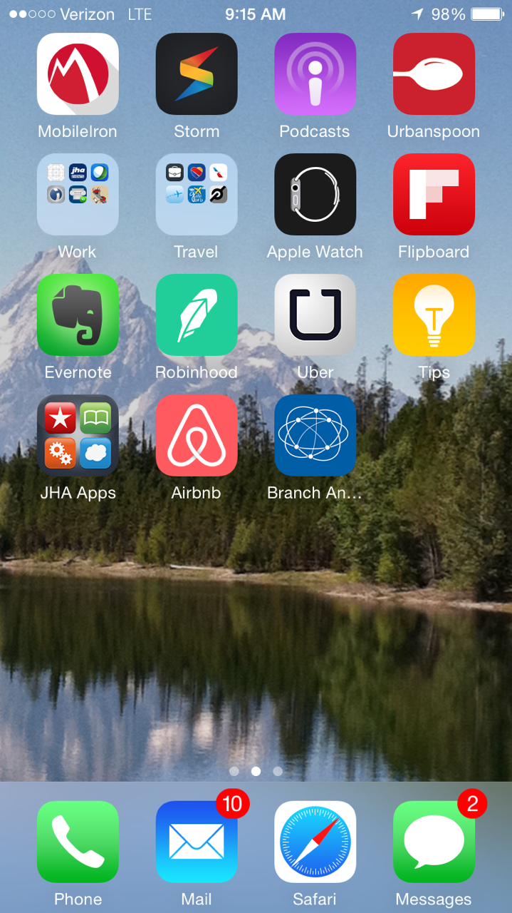
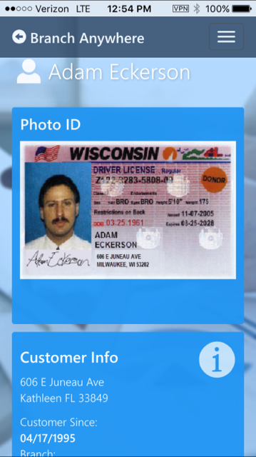
The Bank Associate Experience

Slide 38
Dashboard Tablet/Phone

Slide 39
Transaction History – Tablet/Phone

Slide 40
Branch Anywhere Roadmap
Platform (highest priority)
BSA
eSign
Remote deposit
More Synapsys®
iPay™
PowerOn®
Wires
jhaID Scan™
Document merge
Doc image inquiry

Slide 41
Deposit Origination

Slide 42
Integration
CRM (Synapsys) Referral
Deposit Platform (OnBoard Deposits)
Identity Verification Inquiry
OFAC Verification
Check Ordering Interface
ATM / Debit Card
AFT / ACH / Sweeps
Combined Statements
Internet Banking (NetTeller)
BSA Integration
Document Imaging / eSignature Capture (Synergy)
Teller Funding (SilverLake Teller) and Signature Inquiry
Internet Banking (NetTeller) Inquiry/Activity
Mobile Banking (goDough) Inquiry/Activity
SilverLake Inquiry and Document Imaging Inquiry (Synergy)

Slide 43
Features of OnBoard Deposits
OnBoard Deposits features a customer centric process where account opening input is based on type of transaction and data required to complete in a timely and compliant manner.
Supports compliance based dynamic forms from CSi and WKFS.
Provides interest calculators, quick links, and quick documents in a single sign-on environment to make users efficient and able to deliver a positive customer experience.
Complementary Interfaces (via jXchange™)
Synergy eSign™
YellowHammer BSA
PassPort
Customer Verification with ChexSystems or Deluxe Detect
Check Vendor
OnBoard Product Roadmap for Integration
Online Banking (NetTeller)
CRM (Synapsys)
jhaIDScan
Maintenance Integration
jhaEnterprise Workflow
Branch Anywhere

Slide 44
Teller Operations

Slide 45
SilverLake Teller…..A Complete Solution
Transaction Processing
Teller Capture
CTR Automation
Cash Dispensers & Recyclers
Reg CC Automation
Check Printing
Bond Redemption

Slide 46
eSign, iSign, eSign Web

Slide 47
What is the Synergy eSign Suite?
The Synergy eSign Suite digitally captures legally binding signatures from platform documents.
Permanently embeds the signatures into PDF files.
Stores PDF documents in the Synergy Document Module.
Enables multiple signatories to sign documents electronically in person or over the internet (blended signatures).
Eliminates copying, scanning, and manual indexing of paper documents into the Synergy Document Module.

Slide 48
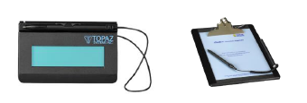
Synergy eSign Suite
Synergy eSign – In Person
Synergy iSign – In Person Untethered
Synergy eSign Web - Remote

Slide 49
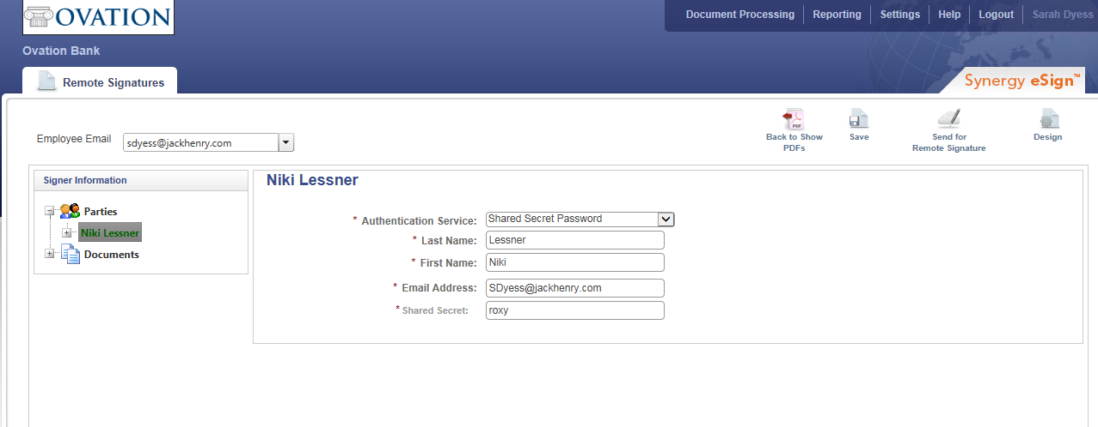
Sending for Electronic Signature
Notes:
Two authentication methods:
Shared Secret Password
KBA or Knowledge Based Authentication

Slide 50
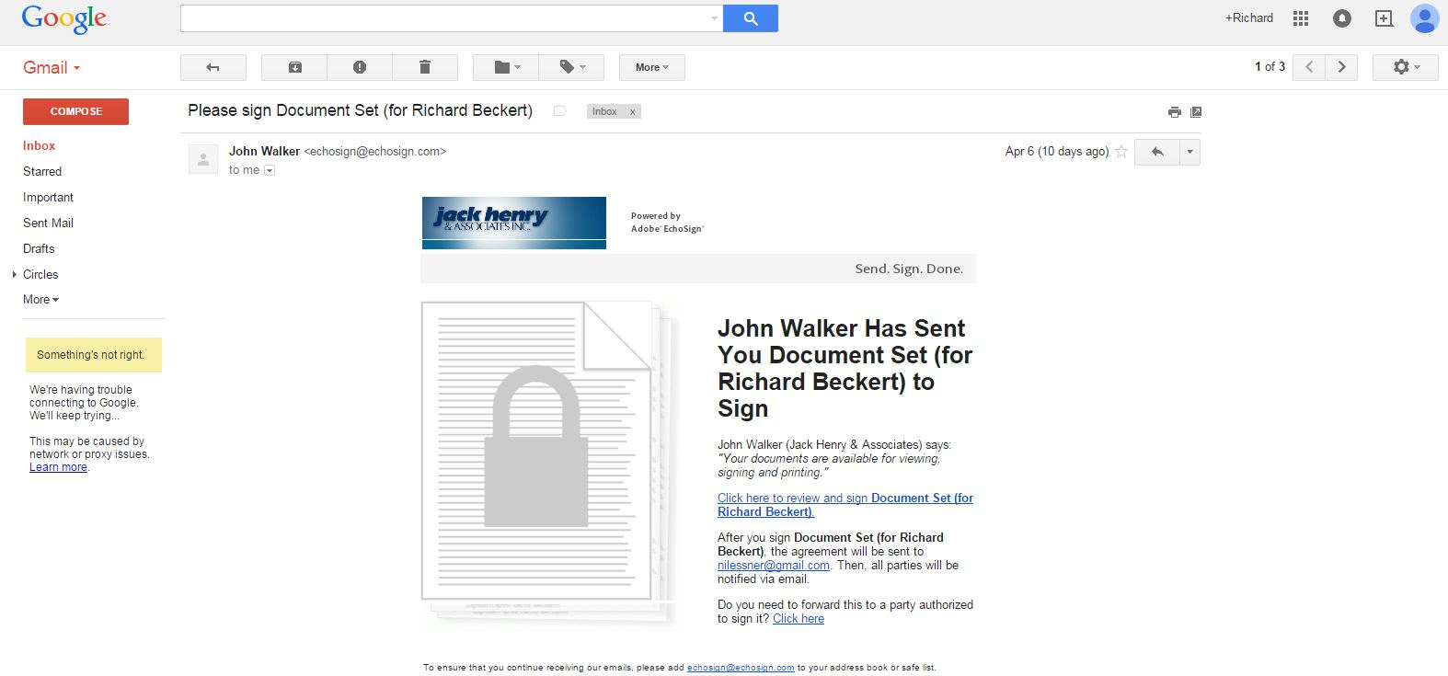
Customer E-mail
Notes:
Customer’s email is bank branded. Bank colors, logo…

Slide 51
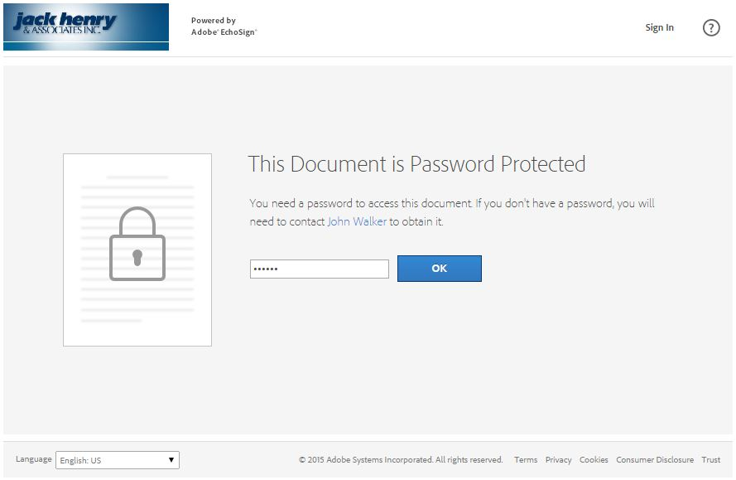
Customer Authenticates
Notes:
Two authentication methods:
Shared Secret Password
KBA or Knowledge Based Authentication

Slide 52
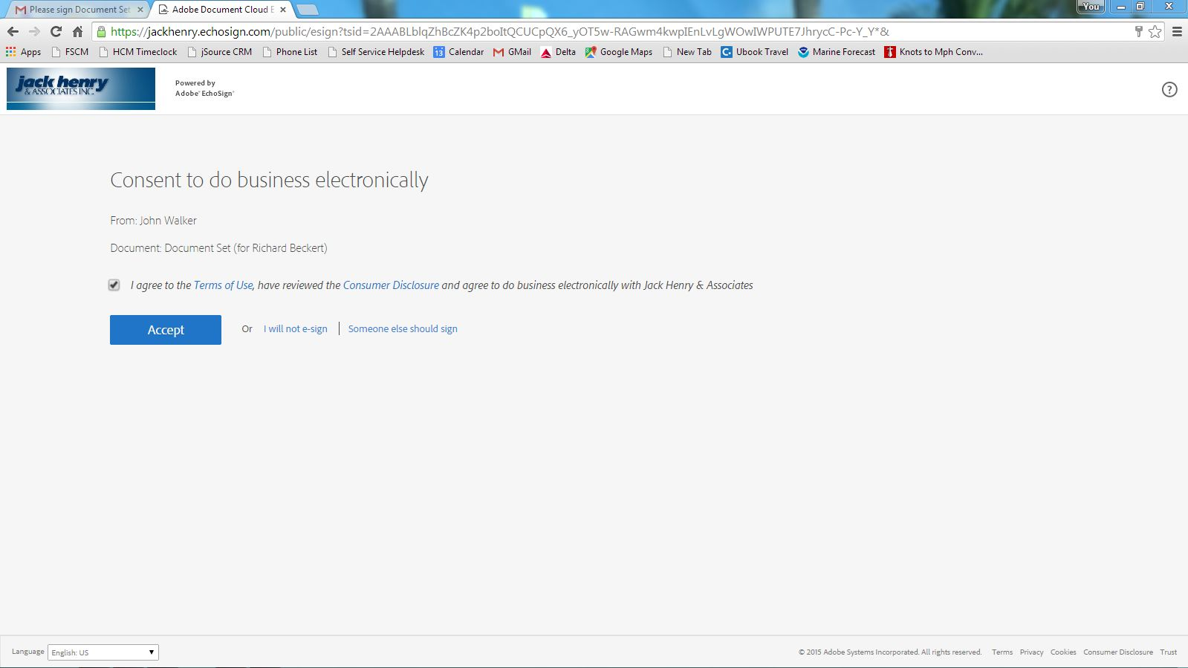
Consent To Do Business Electronically

Slide 53
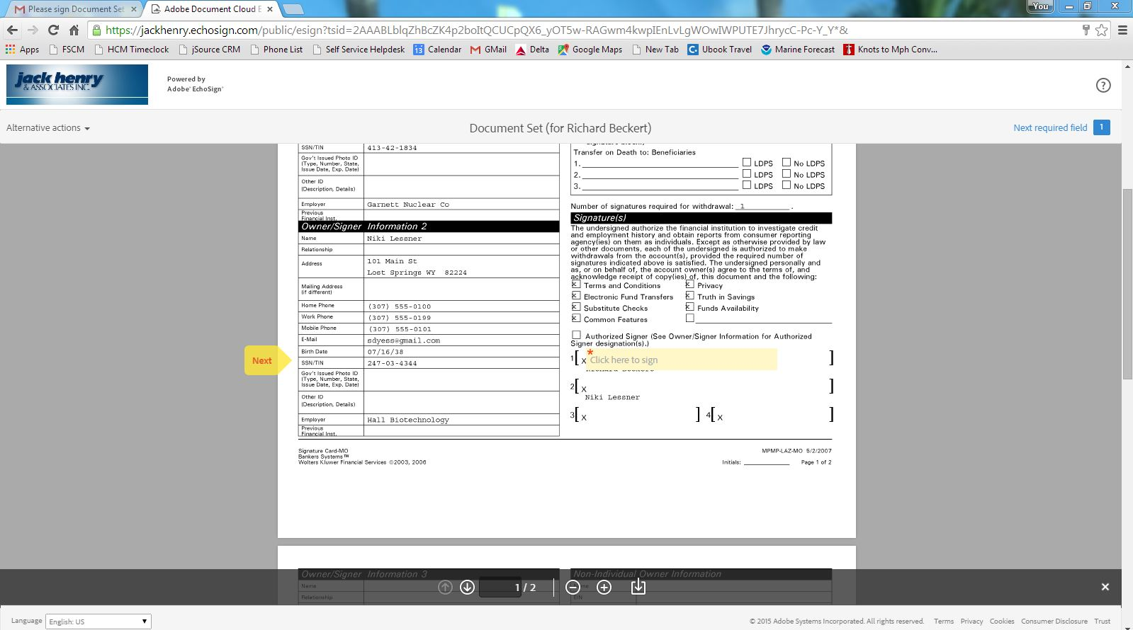
Navigate to Signatures

Slide 54
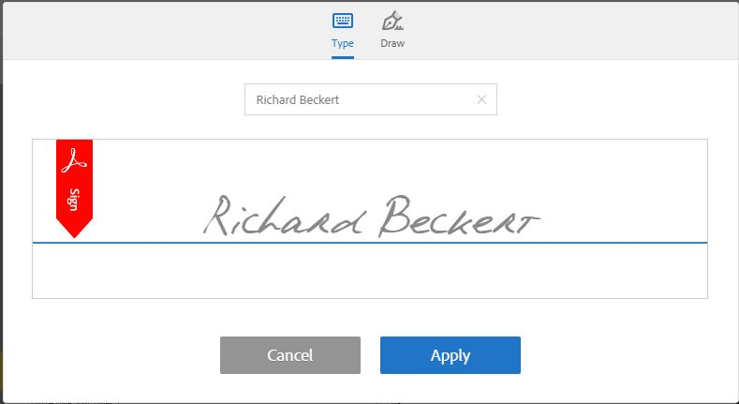
Customer Signs
Notes:
Customer may either type name or click the draw icon to draw their signature on virtually any touch screen device.

Slide 55
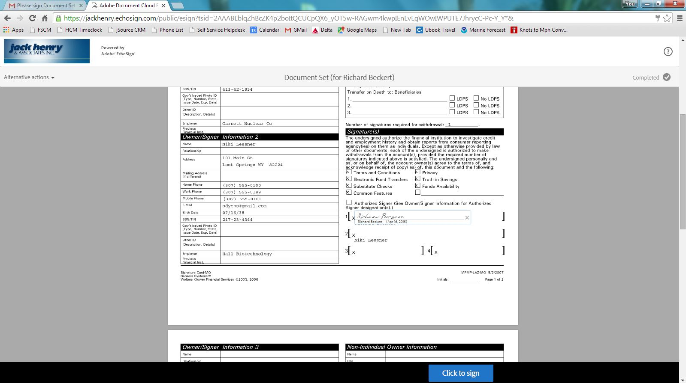
Accept Signatures

Slide 56
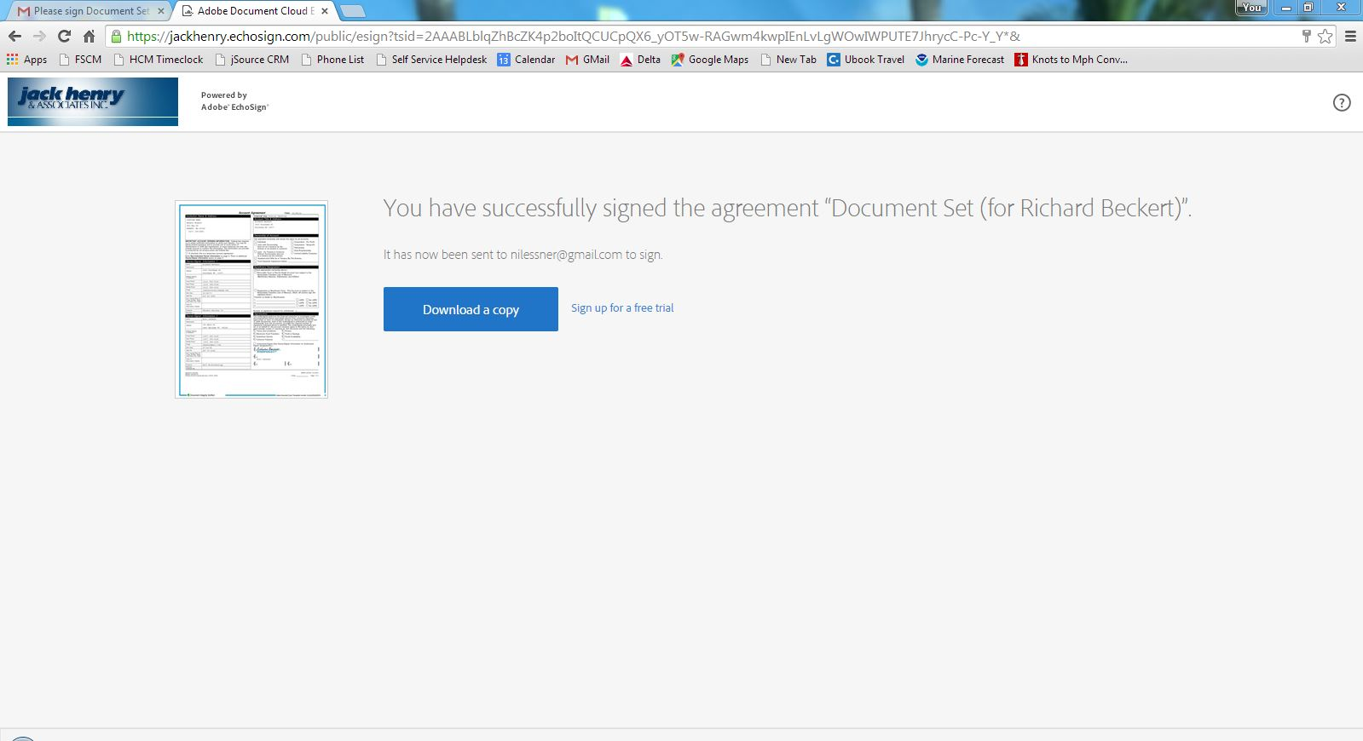
Download a Copy
Notes:
Customer may download their document(s).

Slide 57
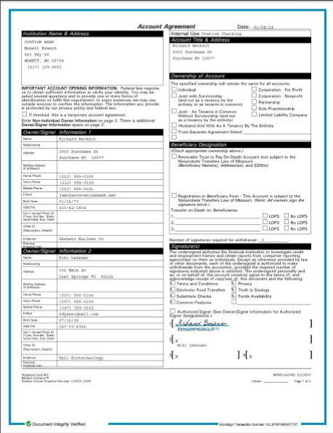
Encrypted Completed Documents
Notes:
Customer may download their document(s).

Slide 58
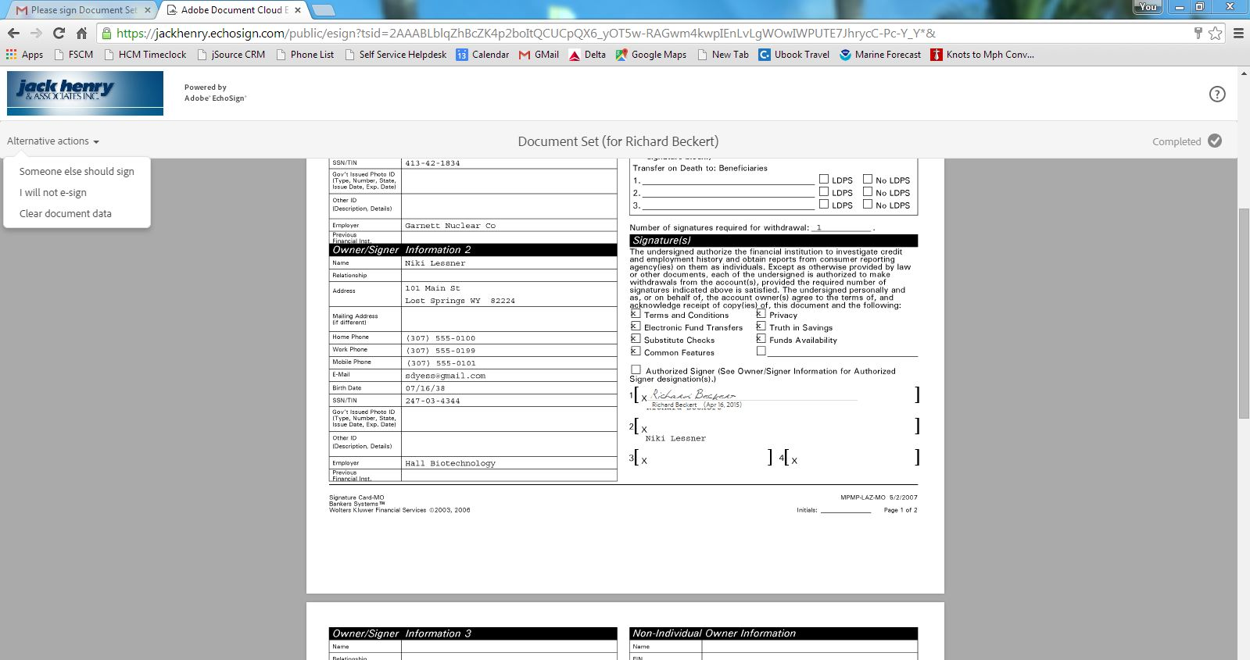
Opt-Out

Slide 59
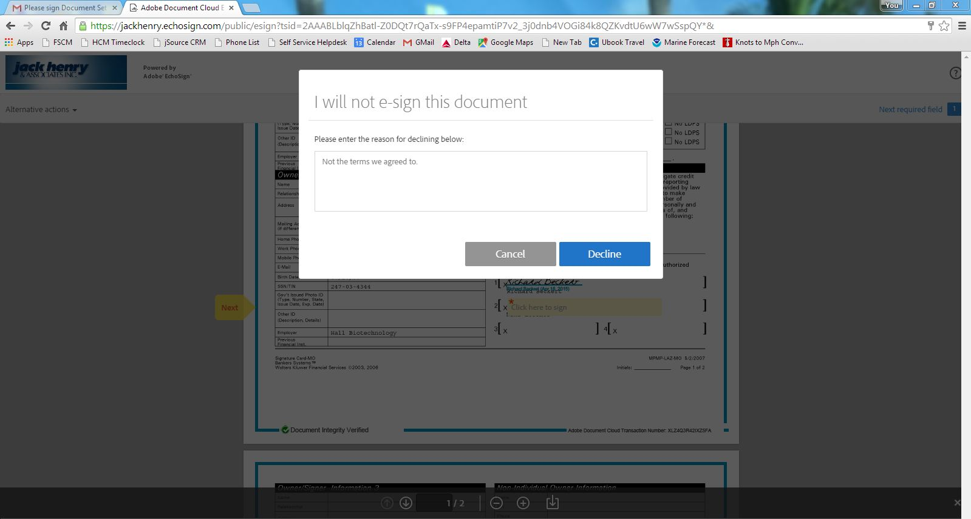
Opt-Out Reason
Notes:
Customer must type a reason then click Decline.

Slide 60
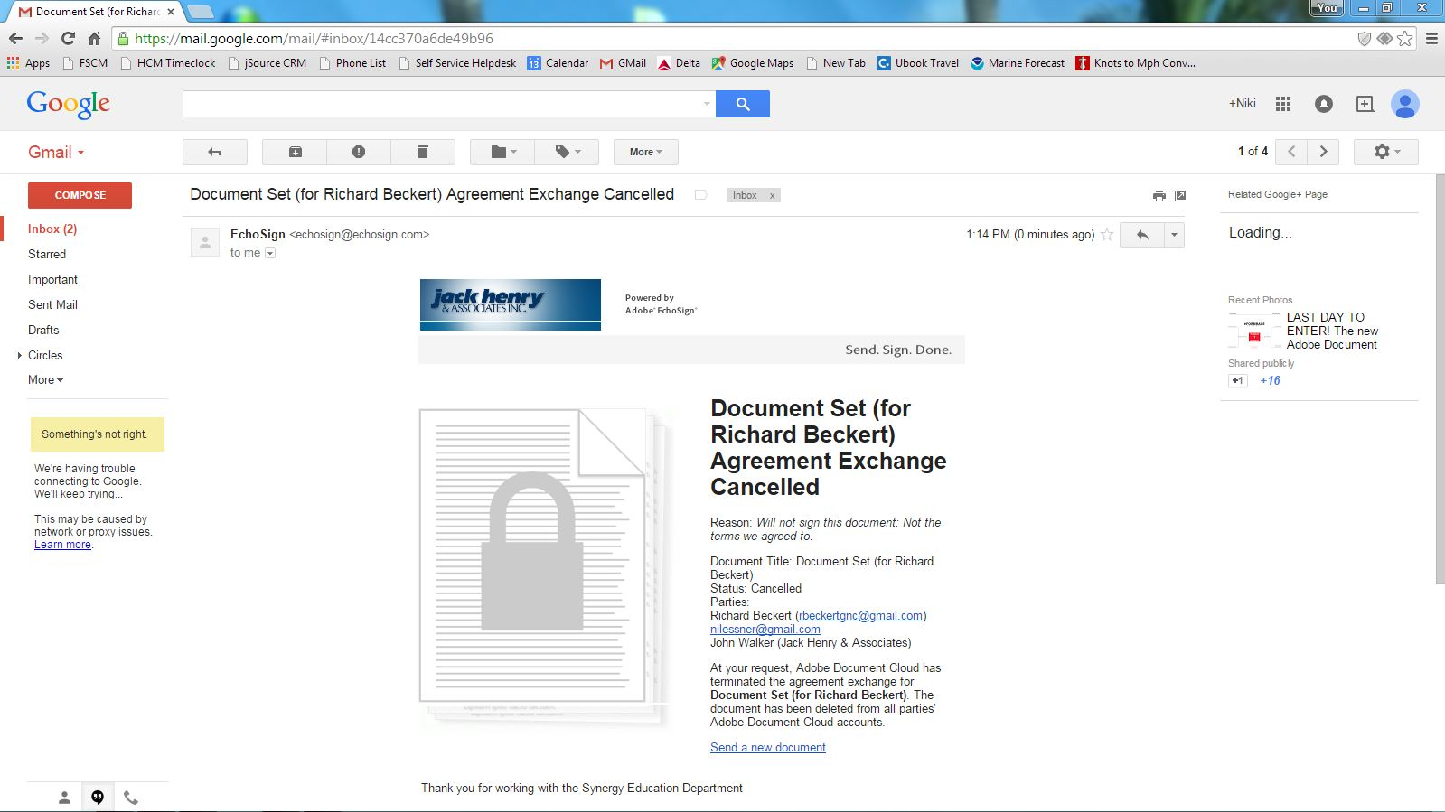
Opt-Out E-mail

Slide 61
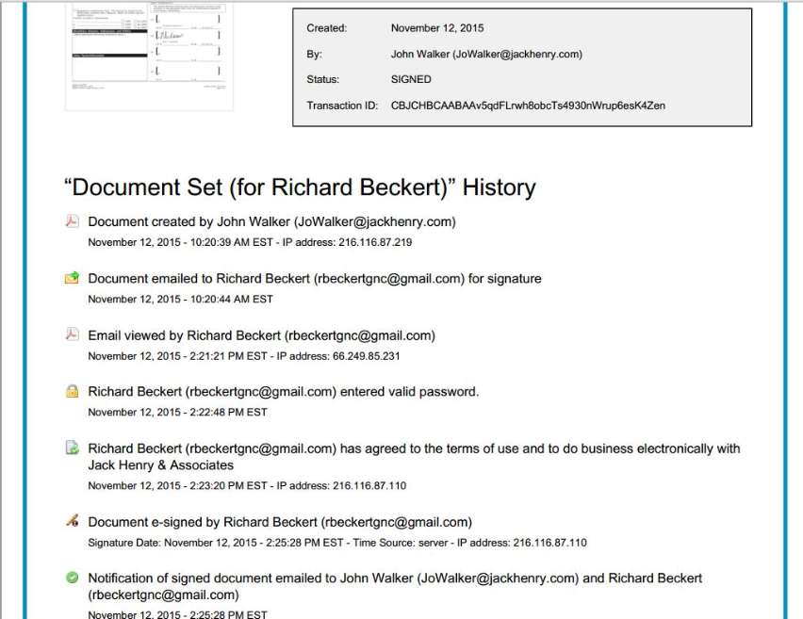
Audit Trail

Slide 62
Taking Technology Outside of the Bank

Slide 63
Branch Anywhere
Branch Anywhere™ is the first JHA companion app
Any Product, Any System, Anywhere
Powered 100% by jXchange™
Complementary Product Integration
Synergy™
4|sight™
jhaPassPort™
NetTeller®
Synapsys®
iPay™
Coming Soon: Teller, Argo ®, OnBoard™

Slide 64
Branch Anywhere Live Demonstration

Slide 65
Actions & Alerts
Alerts (Customer and Account Alerts from Core)
No Email
No Internet Banking (NetTeller®)
Bad Address
No Cell Phone
No Reg E Election
No Active Debit Card (jhaPassPort™)
We will continue to build out additional actions/alerts based on customer feedback

Slide 66
Services
Phone Number Maintenance
Email Maintenance
Customer Address Maintenance
Reg E Election Maintenance
Transfers (Active DDA account to account)
Internet Banking Pin Reset (NetTeller®)
Debit Hot/Warm Card (jhaPassPort™)
Temporary Debit Card Limits (jhaPassPort™)
Debit Card PIN Reset (jhaPassPort™ requires First PIN module)
CRM Service Events & Referrals (Synapsys®)
iPay

Slide 67
Dashboard Tablet/Phone

Slide 68
Transaction History – Tablet/Phone

Slide 69
Branch Anywhere Roadmap
Platform (highest priority)
BSA
eSign
Remote deposit
More Synapsys®
iPay™
PowerOn®
Wires
jhaID Scan™
Document merge
Doc image inquiry

