Slide 1
Card Processing Solutions
Jack Henry & Associates, Inc.®
Peter Goodrich-EFT Sales Executive
May 4th, 2017
JHA SilverLake Mid-Atlantic Regional Users Group

Slide 2
Agenda
CPS Update
EMV Discussion
Digital Wallets
Card Controls and Alerts

Slide 3
Jack Henry & Associates Announces Strategic Partnerships with First Data and PSCU
Strategic Service Agreement –
Relationships enhance existing credit and debit card suite, respond to demand for full-service processing, enhanced fraud monitoring, and sophisticated analytics

Slide 4
CPS Update
Integration of Debit & Credit Processing Platform
Enhanced Analytics, SAS, FICO, etc.
Executive Dashboards
Enhanced Fraud Monitoring – FICO Falcon Real-time
Rewards and Loyalty Programs
Referral Partner for STAR

Slide 5
CPS ATM & Debit Card Processing Suite
EMV (EuroPay MasterCard VISA) Chip Card
National Network Certifications Completed
Regional Network Certifications Completed
Card Producers Certifications Completed
More than 361 customer projects in process
More than 452 customers with EMV cards active
We have certified ATM vendors Diebold, NCR & Hyosung
Apple Pay, Android Pay and Samsung Pay
More than 211 FI’s using Apple Pay
More than 61 Android and 17 Samsung FI’s live, 120+ projects in the queue

Slide 6
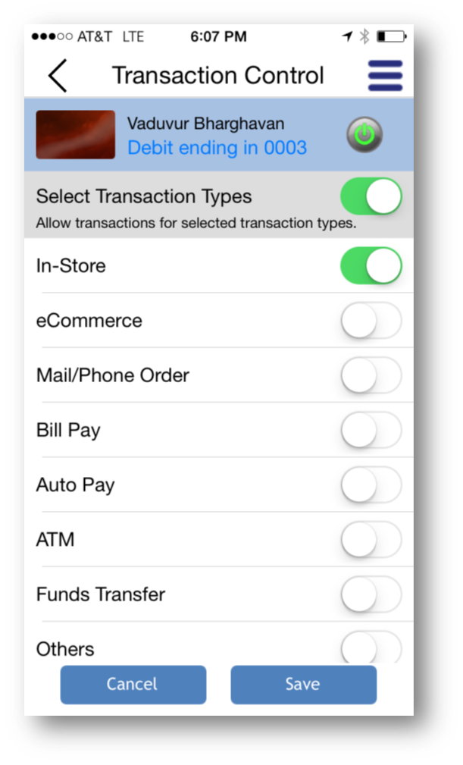
Card Usage Control
Customize Transaction Types
Enable specific types of transactions
Cardholder Limits
Set dollar limits based on merchant, category , transaction type
specify time windows and days of acceptable use.
Dependent Card Controls
Parent-Child relationships or Employer-Employee

Slide 7
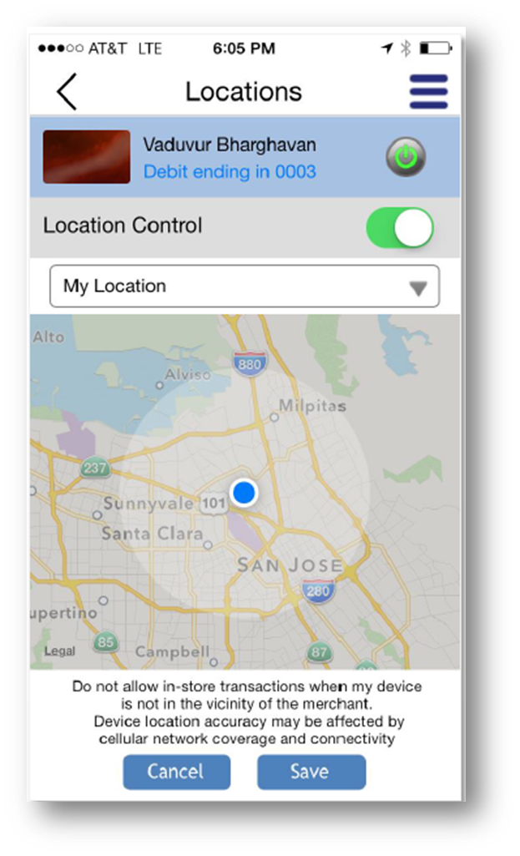
Card Usage Control
Cards On/Off Instantly
Status is changed immediately
Geolocation of Mobile Phone and Transaction Location
Cardholders can keep their card active around them or only within a specified region on a map
Merchant or Merchant Categories
Enable specific merchants or categories of merchants

Slide 8
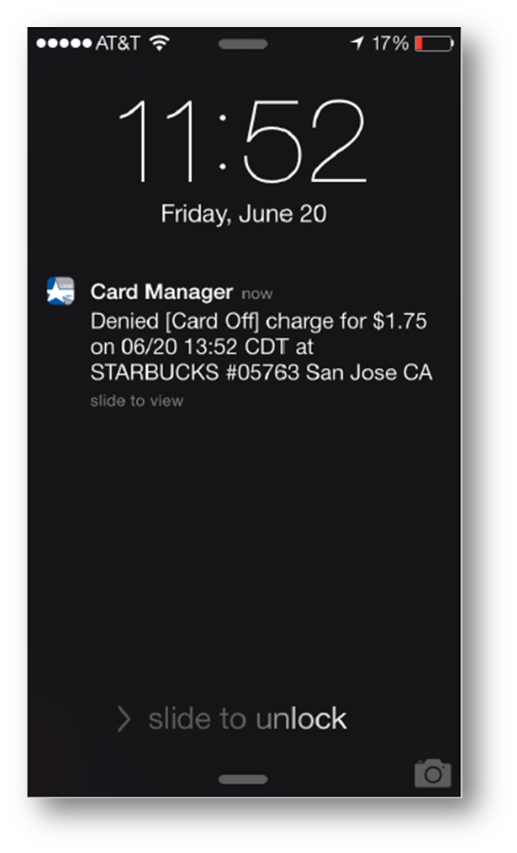
Enhanced Card Activity Alerts
Alert All Transactions
Enable alerting for all transactions in real-time
Geolocation Mobile Phone and Transactions
Instant alerts for any card present transaction that is outside the vicinity of the cardholder’s mobile phone or outside a specified region on a map
Merchants or Merchant Categories
Cardholders are alerted for transactions with specific merchants or categories of merchants
Customize Transaction Types and Limits
Cardholders are alerted for specific types of transactions like online, in-store, ATM, etc. or are over an established spending limit.

Slide 9
CPS Fraud Center
Its purpose…
To provide an effective tool to manage risk by minimizing the impact of fraud to cardholders and to the institution by increasing fraud protection and reducing fraud losses.

Slide 10
FICO Falcon & CCS
Transaction Profiling
Consortium Data Risk Models
Neural Network Technology
Expert Rules
Powerful Scoring Engine
Notes:
The JHA PassPort Fraud Center (aka Risk Management) uses PRISM®, an intelligent risk management system that monitors, detects and prevents on-going debit card fraud. PRISM combines the pattern recognition power of neural network transaction scoring technology and custom risk models with expert rules-based strategies to manage and control fraud losses. This solution is an effective tool to help issuers manage risk associated with ATM, VisaCheck®, Debit MasterCard®, and Discover Debit® cards. This system is capable of creating alerts based on rules, models, cardholders’ spending habits and logic to detect possible fraudulent activity within minutes of the transaction, while maintaining a low false positive rate. The advanced process allows scoring to take place outside the critical authorization processing path so meaningful results are obtained with minimal impact to cardholders.
High risk transactions are identified and reviewed by a fraud analyst. If fraud is suspected, the fraud analyst will attempt to contact the cardholder to verify the legitimacy of the transactions. If fraud is confirmed by the cardholder, the card is immediately disabled to prevent further activity and the cardholder is instructed to contact their financial institution. If the cardholder is not available to confirm the activity, the card will be temporarily blocked until the cardholder contact is made.
The Fraud Center:
Identifies potentially fraudulent transactions early in the fraud cycle.
Offers opportunities to minimize the impact of fraudulent transactions.
Provides complete and timely transaction review.
Allows quick, positive action to reduce future fraud losses on behalf of PassPort clients.
In addition, this comprehensive service is intended to enhance customer service, result in a positive impact on revenue and provide a better understanding of dynamic fraud behavior.

Slide 11
Fraud Center (CCS) Customer Contact Solution
Supports Email, Voice, and SMS/text alerts delivery
Escalation process manages customer contact
Automates dialing for faster cardholder contact
and resolution
Cardholder can confirm transactions within
the system or speak to a fraud analyst

Slide 12
MasterCard Expert Monitoring System (EMS)
The MasterCard Expert Monitoring System (EMS) supports strategic sourcing, mines card data, and provides a state-of-the-art solution for risk management, fraud detection and mitigation, detection of internal misuse, and compliance monitoring and reporting.
This score will be used to detect and stop fraud at the first transaction.

Slide 13
Legal Disclaimer: Dates contained in this document are provided as estimates only and can be changed at any time at the sole discretion of Jack Henry & Associates, Inc. This information may not be incorporated into any contract and should not be relied upon in making purchasing decisions.
HANK YO FOR THE OPPORTUNITY TO SHARE JHA’S STORY
Notes:
This slide must be included in all presentations that include dates of future deliverables.
The following, smaller disclaimer should appear on each subsequent slide that contains a date of future deliverables:
Dates contained in this document are provided as estimates only and can be changed at any time at the sole discretion of Jack Henry & Associates, Inc.

